Slide 1
zekeLabs
Learning made Simpler ! www.zekeLabs.com

Slide 2
Docker Networking

Slide 3
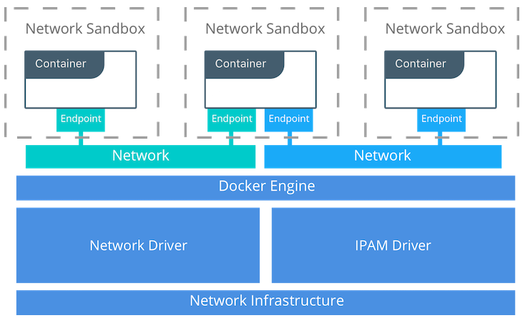
Container Networking Model (CNM)

Slide 4
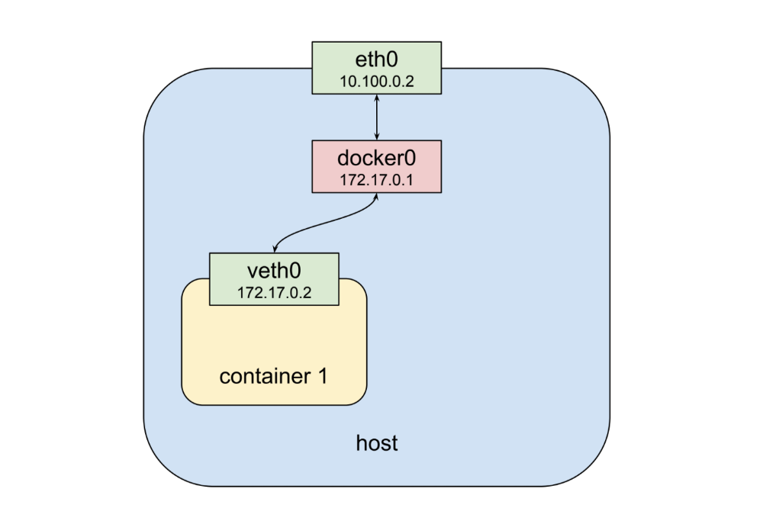
networking
Physical network interface eth0
Bridge (default gateway for veth) docker0
virtual network interface veth0

Slide 5
Challenges of Networking Containers and Microservices
Portability
How do I guarantee maximum portability across diverse network environments while taking advantage of unique network characteristics?
Service Discovery
How do I know where services are living as they are scaled up and down?
Load Balancing
How do I share load across services as services themselves are brought up and scaled?

Slide 6
Challenges of Networking Containers and Microservices
Security
How do I segment to prevent the wrong containers from accessing each other?
How do I guarantee that a container with application and cluster control traffic is secure?
Performance
How do I provide advanced network services while minimizing latency and maximizing bandwidth?
Scalability
How do I ensure that none of these characteristics are sacrificed when scaling applications across many hosts?

Slide 7
Container Networking Model Constructs
Sandbox
A Sandbox contains the configuration of a container's network stack.
This includes management of the container's interfaces, routing table, and DNS settings.
A Sandbox may contain many endpoints from multiple networks.
Endpoint
An Endpoint joins a Sandbox to a Network.
The Endpoint construct exists so the actual connection to the network can be abstracted away from the application.

Slide 8
Network Drivers

Slide 9
Network Drivers
Makes Containers Platform-agnostic
Manipulates iptables rules of unix and routing rules on windows.
Provides the actual implementation that makes networks work.
Pluggable so that different drivers can be used and interchanged easily to support different use cases.

Slide 10
Types of network drivers
Native Network Drivers
Native Network Drivers are a native part of the Docker Engine and are provided by Docker.
Remote Network Drivers
Remote Network Drivers are network drivers created by the community and other vendors.
These drivers can be used to provide integration with incumbent software and hardware.

Slide 11
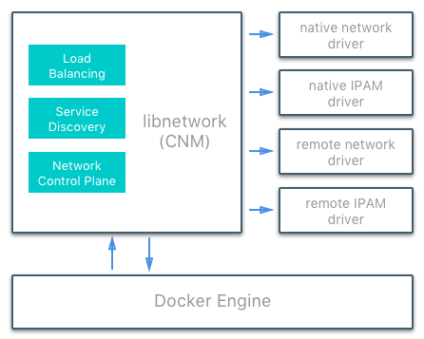
IPAM Drivers

Slide 12
IPAM Drivers
Docker has a native IP Address Management Driver that provides default subnets or IP addresses for networks and endpoints if they are not specified.
IP addressing can also be manually assigned through network, container, and service create commands.
Remote IPAM drivers also exist and provide integration to existing IPAM tools.

Slide 13
Network Scope
The network scope is the domain of the driver which can be the local or swarm scope.
Local scope drivers provide connectivity and network services (such as DNS or IPAM) within the scope of the host.
Swarm scope drivers provide connectivity and network services across a swarm cluster.
Swarm scope networks have the same network ID across the entire cluster while local scope networks have a unique network ID on each host.

Slide 14
Docker Networking : LAB

Slide 15
Without a user-defined bridge network
$ docker network ls
$ docker run -dit --name alpine1 alpine ash
$ docker run -dit --name alpine2 alpine ash
$ docker container ls
$ docker network inspect bridge
$ docker attach alpine1
# ip addr show
# ping -c 2 google.com
Success
# ping -c 2 <ipaddr of alpine2>
Success
# ping -c 2 alpine2
Fails
// Remove all the containers
$ docker container stop alpine1 alpine2
$ docker container rm alpine1 alpine2

Slide 16
With a user defined bridge network
$ docker network create --driver bridge alpine-net // create a user defined network alpine-net
$ docker network ls
$ docker network inspect alpine-net
$ docker run -dit --name alpine1 --network alpine-net alpine ash
$ docker run -dit --name alpine2 --network alpine-net alpine ash
$ docker run -dit --name alpine3 alpine ash //alpine3 only connected to bridge not to alpine-net
$ docker run -dit --name alpine4 --network alpine-net alpine ash
$ docker network connect bridge alpine4 //alpine4 connect to bridge as well
$ docker network inspect bridge
$ docker network inspect alpine-net
// Ping from one container to others by name and see the connectivity
// ping from alpine4 which is connected to both

Slide 17
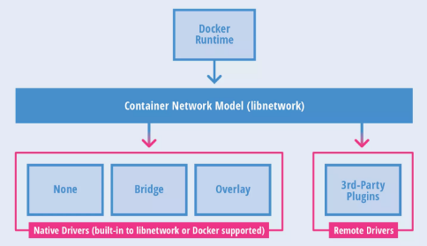
Docker Native Network Drivers

Slide 18
Docker Native Network Drivers
Bridge
The default network driver.
The bridge driver creates a Linux bridge on the host that is managed by Docker.
Host
With the host driver, a container uses the networking stack of the host.
only available for swarm services on Docker 17.06 and higher.
Overlay
The overlay driver creates an overlay network that supports multi-host networks out of the box.
Enables swarm services to communicate with each other

Slide 19
Docker Native Network Drivers
MACVLAN
Macvlan networks allow you to assign a MAC address to a container, making it appear as a physical device on your network.
The macvlan driver uses the MACVLAN bridge mode to establish a connection between container interfaces and a parent host interface
None
The none driver gives a container its own networking stack and network namespace but does not configure interfaces inside the container.
not available for swarm services.

Slide 20
Network Drivers for windows
Nat –
Containers attached to a network created with the 'nat' driver will be connected to an internal Hyper-V switch
Port forwarding / mapping from the container host to container endpoints is supported.
Transparent –
Containers attached to a network directly connected to the physical network through an external Hyper-V switch.
IPs from the physical network can be assigned statically (requires user-specified --subnet option) or dynamically using an external DHCP server.
Requires: When this mode is used in a virtualization scenario (container host is a VM) MAC address spoofing is required.
So not supported on Azure VMs

Slide 21
Docker Remote Network Drivers
Contiv
An open source network plugin led by Cisco Systems to provide infrastructure and security policies for multi-tenant microservices deployments.
Weave
A network plugin that creates a virtual network that connects Docker containers across multiple hosts or clouds.

Slide 22
Docker Remote Network Drivers
Calico
An open source solution for virtual networking in cloud datacenters. It targets datacenters where most of the workloads (VMs, containers, or bare metal servers) only require IP connectivity.
Kuryr
A network plugin developed as part of the OpenStack Kuryr project.

Slide 23
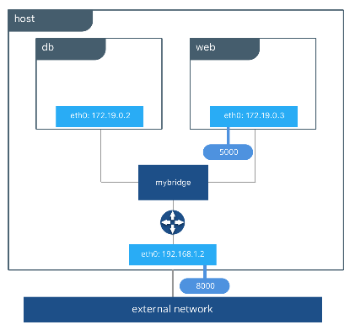
Bridge Networks

Slide 24
Bridge Networks
In terms of Docker, a bridge network uses a software bridge which allows containers connected to the same bridge network to communicate, while providing isolation from containers which are not connected to that bridge network.
The bridge driver creates a private network internal to the host so containers on this network can communicate. External access is granted by exposing ports to containers. Docker secures the network by managing rules that block connectivity between different Docker networks.

Slide 25
User-defined and default bridge
User-defined bridges provide better isolation and interoperability between containerized applications.
User-defined bridges provide automatic DNS resolution between containers.
Containers can be attached and detached from user-defined networks on the fly.
Each user-defined network creates a configurable bridge.
Linked containers on the default bridge network share environment variables.

Slide 26
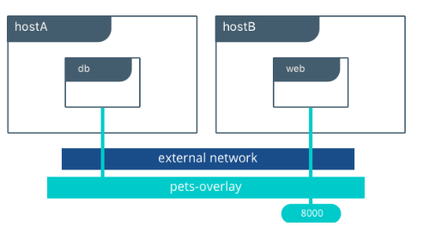
Overlay Network Drivers

Slide 27
Overlay Network Drivers
The overlay network driver creates a distributed network among multiple Docker daemon hosts.
This network sits on top of (overlays) the host-specific networks, allowing containers connected to it (including swarm service containers) to communicate securely.
Docker transparently handles routing of each packet to and from the correct Docker daemon host and the correct destination container.

Slide 28
Host Network Drivers
If you use the host network driver for a container, that container’s network stack is not isolated from the Docker host.
For instance, if you run a container which binds to port 80 and you use host networking, the container’s application will be available on port 80 on the host’s IP address.
The host networking driver only works on Linux hosts, and is not supported on Docker for Mac, Docker for Windows, or Docker EE for Windows Server.

Slide 29
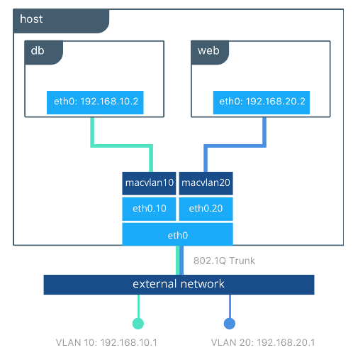
Macvlan Network Drivers

Slide 30
Macvlan Network Drivers
Some applications, especially legacy applications or applications which monitor network traffic, expect to be directly connected to the physical network.
In this type of situation, you can use the macvlan network driver to assign a MAC address to each container’s virtual network interface, making it appear to be a physical network interface directly connected to the physical network.

Slide 31
THANK YOU
Let us know how can we help your organization to Upskill the employees to stay updated in the ever-evolving IT Industry.
Get in touch:
www.zekeLabs.com | +91-8095465880 | info@zekeLabs.com
Visit : www.zekeLabs.com for more details

